Slide 1
The endocrine system
Introduction, oxytocin,
ADH, growth hormone
Dr. Ken Wojcikowski
PhD, Pharmacology, UQ School of Medicine

Slide 2
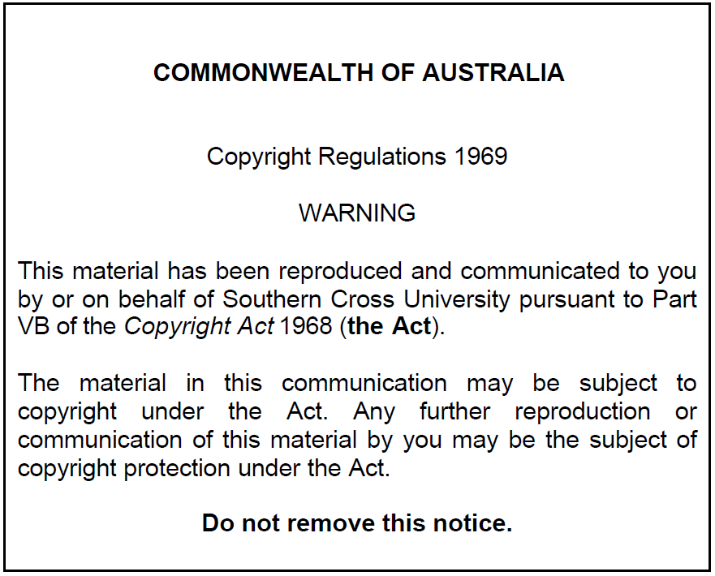

Slide 3
Objectives
  Define the ‘endocrine system’ and ‘hormone’
  Give an example of a homeostatic control mechanism involving ‘negative feedback’.
  Explain the reason that the hypothalamus is thought to be the controlling organ of the endocrine system.
  Explain the effects of the two hormones secreted from the posterior pituitary gland (oxytocin and ADH) and give an example of when they would be useful as a pharmaceutical agent.
  Explain the actions of growth hormone and the results of excesses and deficiencies during childhood and after puberty.
  Drugs to know: Desmopressin, somatropin, vasopressin, oxytocin

Slide 4
PHAR2001_2_5_1
kjhkjhlkdfs
Medications of the Endocrine System:
Lesson 1
Review of the Endocrine System – Part 1

Slide 5
Definitions
The endocrine system: is a system of glands that secrete hormones directly into the circulatory system. From there, the hormones are often carried to a distant organ.
  The endocrine system is in contrast to the exocrine system, which secretes its hormones using ducts.
Hormones: From the Greek word meaning "impetus“; A biochemical that is produced by glands in the body transported ** by the circulatory system to another organ to regulate physiological and behavioural activities. They serve as a form of communication
    **A few hormones act locally as well (oestrogen, testosterone).

Slide 6
Hormones
  Chemical messengers normally secreted into the bloodstream
  Specific rates and rhythms of secretion
    Diurnal, pulsatile and cyclic, and patterns depending on circulating substances
  Operate within feedback systems
  Affect only cells with appropriate receptors
  The liver inactivates hormones, rendering the hormones more water soluble for renal excretion

Slide 7
Mechanisms of
hormone action
Hormones produce cellular changes in target cells – examples:
Stimulate mitosis
Induce secretory activity
Stimulate protein synthesis
Activate or deactivate enzyme systems

Slide 8
Regulation of
hormone release
Hormones are released:
  In response to an alteration in the cellular environment
  To maintain a regulated level of certain substances or other hormones
Hormones are regulated by chemical, hormonal, or neural factors
  Negative feedback
  Positive feedback (rarely)

Slide 9
Hormonal Feedback
-ve
Inhibition
GH
Usually negative
Seldom positive
  Example: day 12 of the menstrual cycle, increasing levels of oestrogen from ovary act on hypothalamus to INCREASE release of GRH
Hypothalamus
Releases GHRH
Pituitary
Releases GH

Slide 10
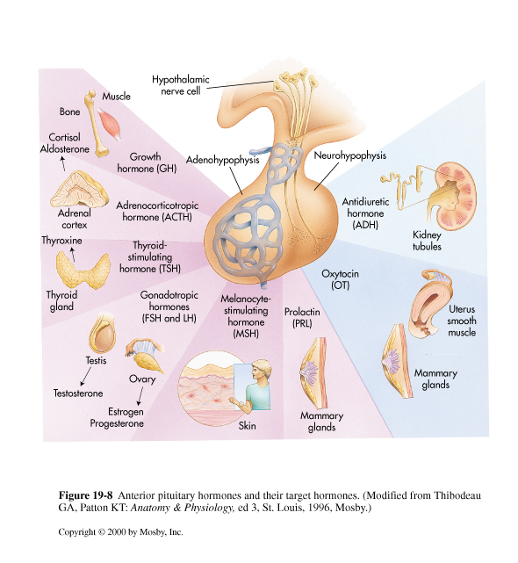
Feedback
loop
Hypothalamus / Pituitary
Hypothalamus
Receives neural
endocrine and
other signals
Pituitary
Releases
Numerous hormones
Target gland
Responds with
hormone

Slide 12
PHAR2001_2_5_1
kjhkjhlkdfs
Medications of the Endocrine System:
Lesson 2
Review of the Endocrine System – Part 2

Slide 13
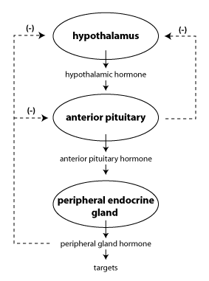
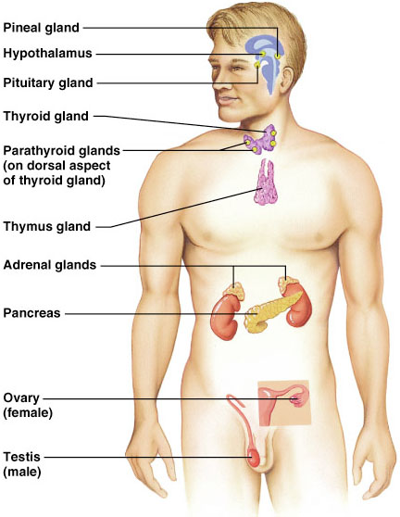
Feedback used in the endocrine system
Most often: negative feedback

Slide 14
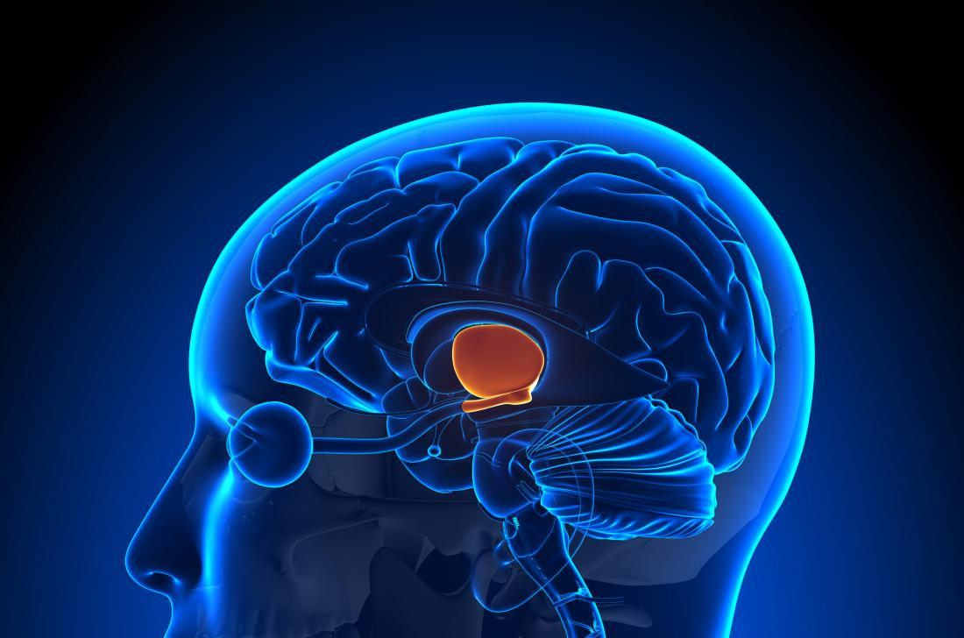
The hypothalamus
A neural and an endocrine organ
Maintains homeostasis
Responds to most hormones of the body
Receives neural signals from most other areas of the brain.
Sends neural information throughout the brain
Synthesizes and secrets its own hormones
Inputs:
  Stress, Pain, Body weight, Temperature, Emotions, Various hormones…
Medical News Today

Slide 15
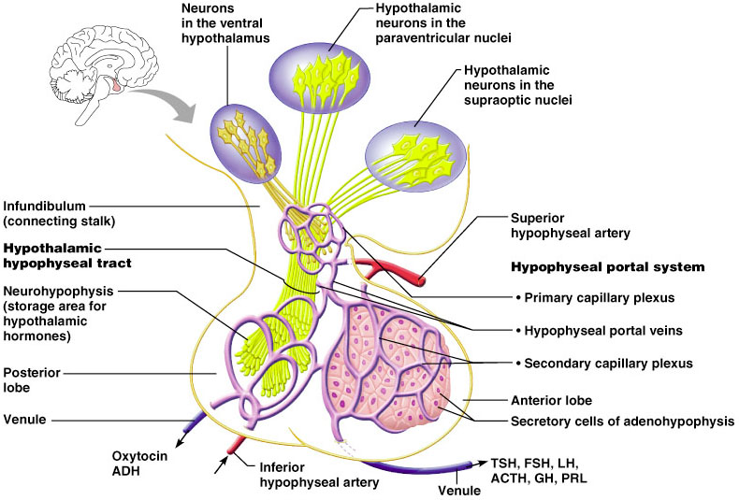
Pituitary
Figure 16.5

Slide 16
Posterior pituitary hormones
Synthesized with their binding proteins in the hypothalamus
Secreted by the posterior pituitary
  Antidiuretic hormone (ADH)
    THE WATER SAVER
    Controls plasma osmolality
  Oxytocin
    Uterine contractions and milk ejection in lactating women

Slide 17
PHAR2001_2_5_1
kjhkjhlkdfs
Medications of the Endocrine System:
Lesson 3
Antidiuretic hormone (ADH)

Slide 18
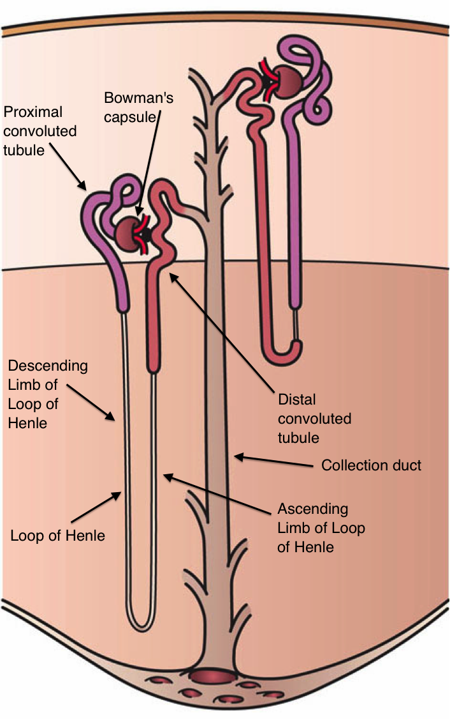
ADH (vasopressin)
Too little ADH, the water saver results in a condition termed diabetes insipidus.
“Diabetes” comes Ancient Greek διαβήτης (diabētēs) which literally means “a passer through; a siphon”
"Insipidus" comes from the Latin: in- "not" + sapidus "tasty" from sapere "have a taste“
Diabetes insipidus is a disease with tasteless urine (in contrast to having sweet urine in diabetes mellitus.) Patients get dehydrated because they cannot save water.

Slide 19
ADH (vasopressin) replacement:
Desmopressin
Synthetic version of ADH, the water saver (vasopressin)
Works like ADH
Main uses include diabetes insipidus but also used in
  Bed wetting
  Nocturia
People using the medication for nocturia should be educated about hyponatremia
Often, intranasal administration

Slide 20
PHAR2001_2_5_1
kjhkjhlkdfs
Medications of the Endocrine System:
Lesson 4
Oxytocin

Slide 21
Oxytocin
Derived from the Greek words meaning ‘swift birth’
The "bonding hormone“, the “love hormone”
Used to initiate labour, control postpartum haemorrhage, (promote breast milk production - no longer in humans)
Relatively safe when used at recommended doses, and side effects are uncommon
Has a half-life of about three minutes when given intravenously. Intranasal oxytocin has a duration of at least 2.25 hours
Replaces the ergot alkaloid ergometrine as the first choice in the uses above, but combinations are still used

Slide 22
PHAR2001_2_5_1
kjhkjhlkdfs
Medications of the Endocrine System:
Lesson 5
Growth Hormone

Slide 23
Growth hormone
Increases muscle mass through sarcomere hypertrophy
Promotes lipolysis
Increases protein synthesis
Your client needs to be told how dangerous it is to use growth hormone for muscle growth!
  Stimulates the growth of all internal organs excluding the brain
  Promotes gluconeogenesis in the liver (increases glucose levels: diabetes!)

Slide 24
Growth hormone deficiency
Growth hormone deficiency (GDH) in childhood is commonly idiopathic (no identifiable cause)
Adult-onset GHD is commonly due to pituitary tumours
Somatropin is given for growth hormone deficiencies
Subcutaneous or intramuscular injections

Slide 25
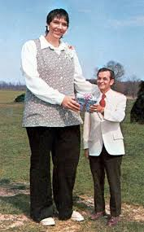
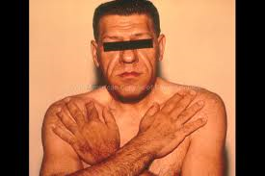
Growth hormone excess
Gigantism occurs when the child is still growing.
Acromegaly occurs after the epiphyseal plates have closed.
Lanreotide is a synthetic analogue of somatostatin, a naturally occurring inhibitory hormone which blocks the release of growth hormone.

Slide 26
References
Thibodeau GA, Patton KT: Anatomy and Physiology 3rd de. Mosby, St. Louis 1996
Patton KT, Thibodeau GA: Mosby’s Handbook of Anatomy and Physiology Mosby, St. Louis 2000
Marieb E: Human Anatomy and Physiology, 5th ed. Benjamin Cummings, San Francisco, 2001
Royalty free images from Shutterstock
The PowerPoint and associated Video were edited and produced by Dr. Ken Wojcikowski

